Slide 1

Biomechanical Analyses of Failure Mechanisms and Design Considerations of Hip Prostheses: Numerical and Experimental Investigations
Prof. Sanjay Gupta, Ph.D. (Delft)
Professor of Mechanical Engineering
Faculty Coordinator, International Relations
Indian Institute of Technology Kharagpur
‹#›

Slide 2

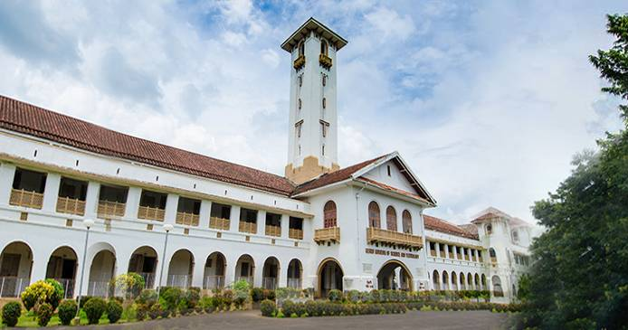
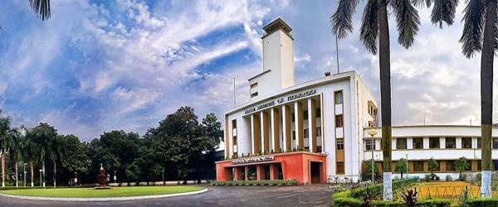

Indian Institute of Technology Kharagpur
“Here in the place of that Hijli detention camp stands this fine monument of India, representing India’s urges, India’s future in the making”

Slide 3
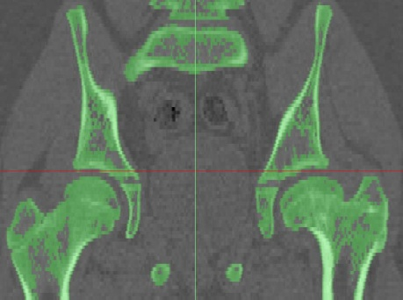
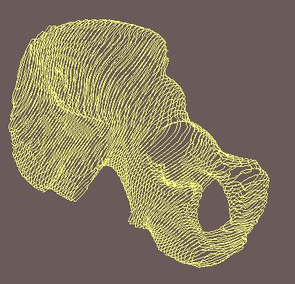
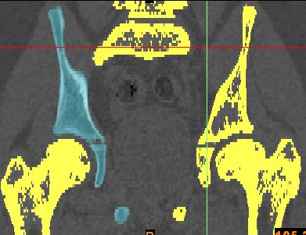
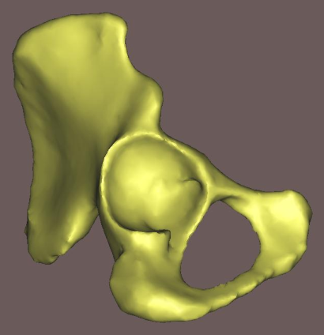
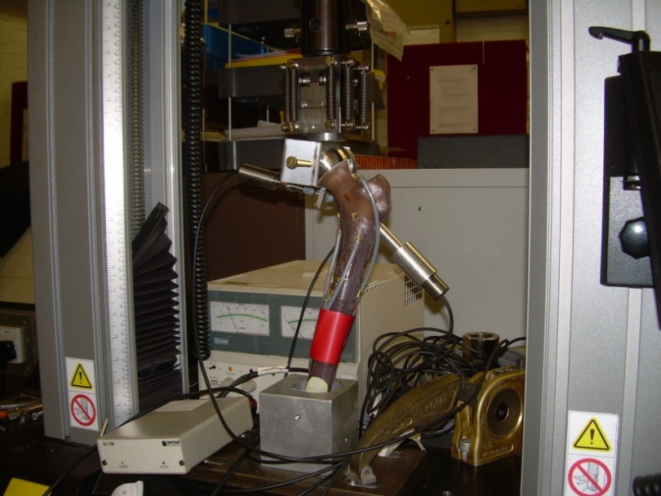
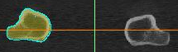
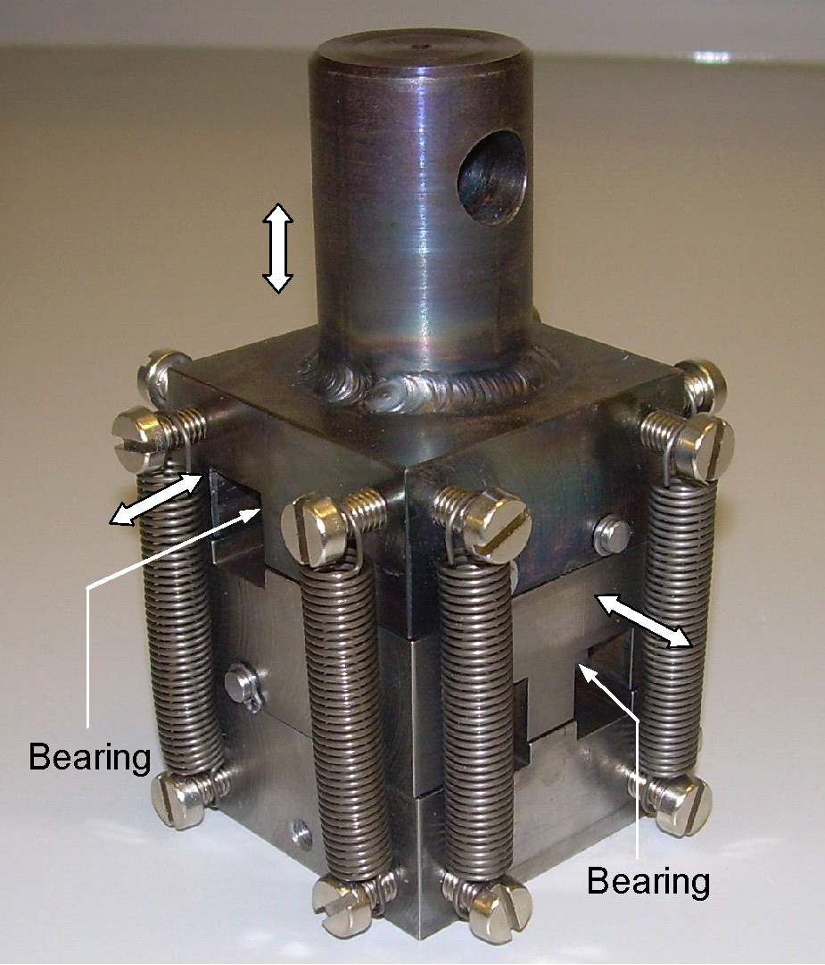
Biomechanics Laboratory
Biomechanics is a subject that seeks to understand the mechanics of living system; it is mechanics applied to biological system. Biomechanics helps to understand the relationship between structure and function, predict changes due to alterations, and propose methods of artificial interventions. Thus diagnosis, surgery and prosthesis are closely associated with Biomechanics.
Computational & Experimental Resources
MIMICS Biomedical Image-processing system
ANSYS, Rhinocerous, Solid Works
High-end PCs for numerical analysis
Zwick (30 KN) Material Testing System
Data Acquisition System (NI with Labview)
In-house fabricated fixtures for biomechanical testing
International and National Collaborations
University of Southampton, UK
Imperial College London, UK
Max Superspecialty Hospital, New Delhi, India
Fortis Hospital, Anandapur, Kolkata.
‹#›

Slide 4
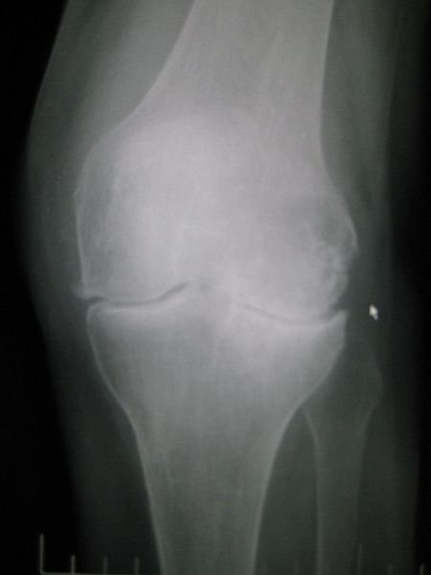
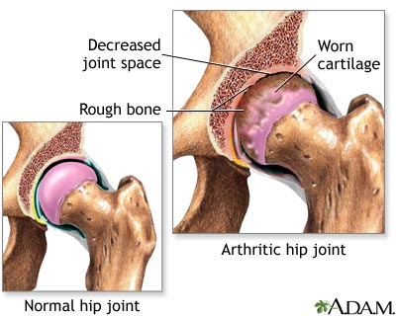
The Clinical Need…
Joint Replacement
Pain and restricted movement and resulting reduction in productivity and quality of life for people with damage to their major joints (hip, knee, shoulder, elbow)
Osteoarthritis 75% of joint replacements
Fracture 12%
Rheumatoid arthritis 4%
Other 7%
Arthritic knee
‹#›

Slide 5
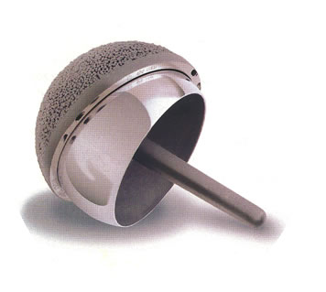
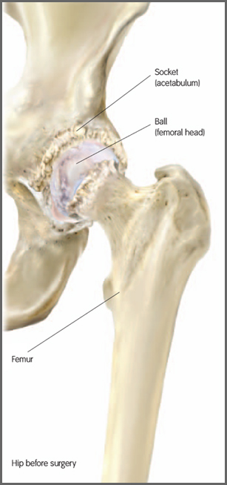
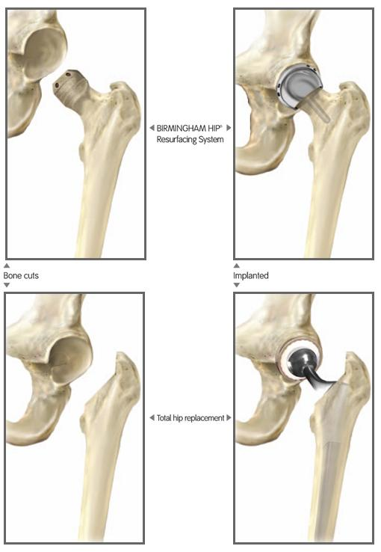
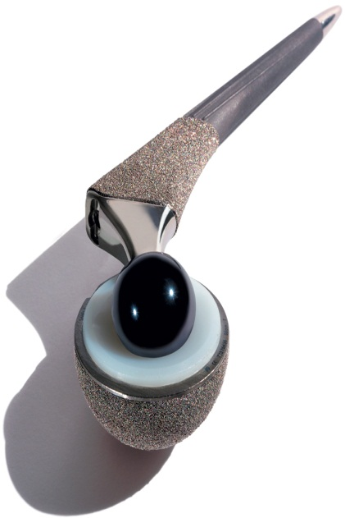
The Treatment…
Total Hip Replacement
ASR resurfacing hip replacement (DePuy)
‹#›
“Synergy” total hip replacement (Smith and Nephew)

Slide 6
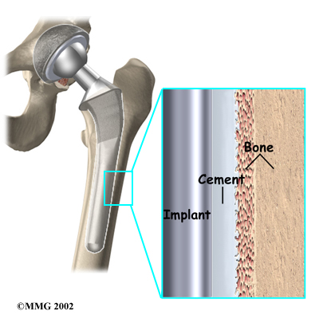
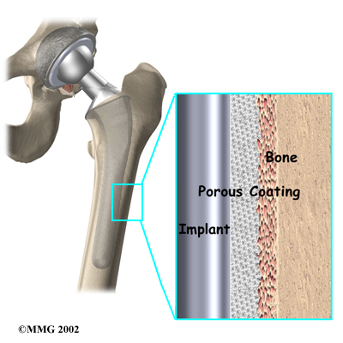
Joint Replacement
The Treatment…
Implant may be fixed to the skeleton with or without bone cement
‹#›
http://www.eorthopod.com/public/hip_guides

Slide 7
Failure Mechanisms
1. Accumulated damage failure scenarios
Interface stresses leading to implant-bone interface debonding.
Excessive implant-bone relative displacement affecting primary fixation.
2. Particulate-reaction failure scenarios
Wear of articulating surface.
Abrasion of cement/prosthesis/bone interface.
3. Stress shielding and bone remodelling
Change in mechanical environment of host-bone, leading to bone loss.
Pre-clinical analysis
Finite Element Analysis (FEA), using Computed Tomography (CT) scan data, of natural bone and implanted bone has commonly been used in Orthopaedic Research to test and validate clinical hypothesis.

Slide 8
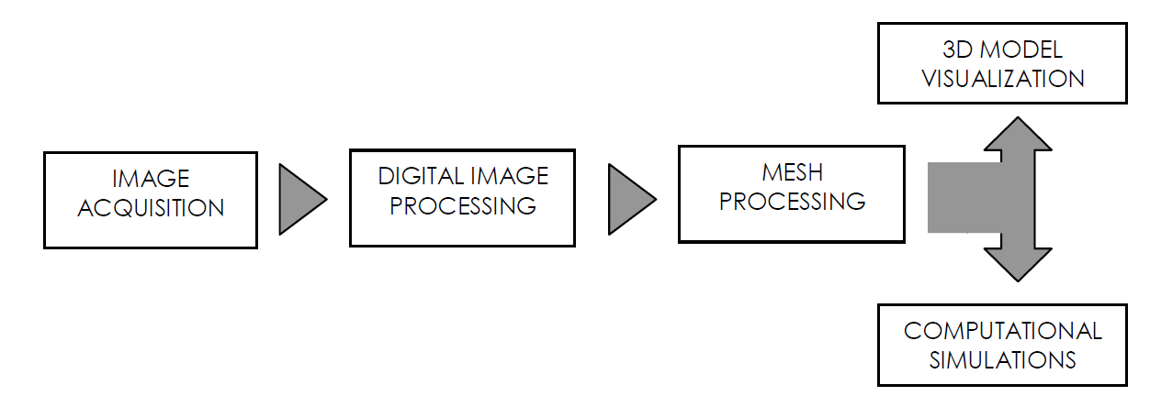
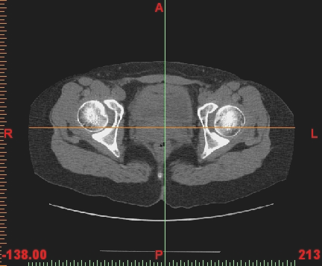
Geometric Reconstruction and Modelling Techniques
SOLID MODEL VISUALIZATION
IMAGE ACQUISITION
DIGITAL IMAGE PROCESSING
SOLID MODELLING
MESH GENERATION &
FE ANALYSIS
Quantitative CT-scan data specification:
Images stored in 512 X 512 pixels
Pixel size 0.5 mm X 0.5 mm
Slice thickness: 1 mm
Distance between slices: 1 mm
‹#›

Slide 9


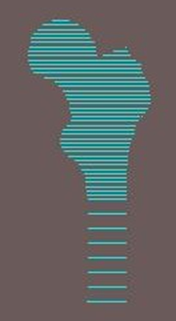
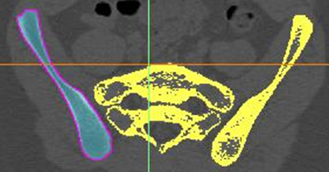
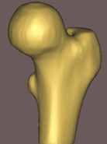
Methods
Segmentation of images isolates structure(s) of interest
Contour/boundary extraction
Surface fitting
Volume generation
Solid modelling operations (e.g. placement of implants)
Finite element meshing
Specialist Software
(e.g. Mimics/Amira)
CAD/FEA Package

Slide 10


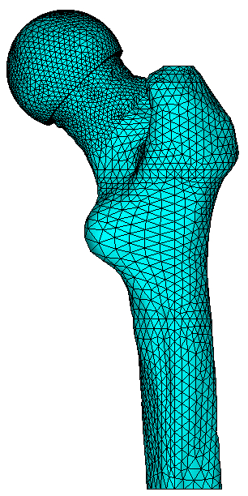
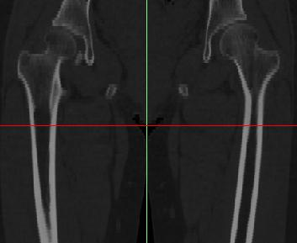

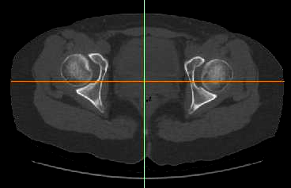
CT-scan image processing and reconstruction
CT scan data of femur
Thresholding, Region growing and Contour detection
contour of the slices, surface fitting and volume generation
Solid modelling operations and FE mesh generation

Slide 11
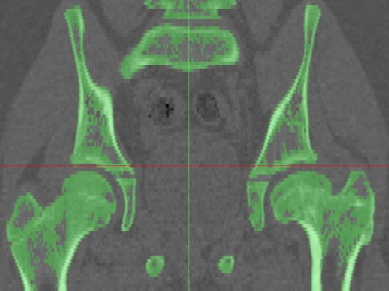
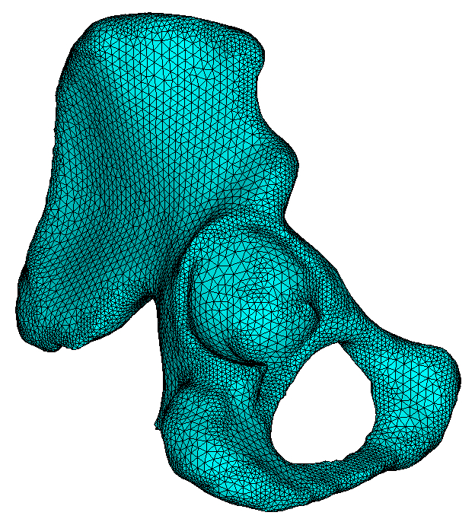

CT-scan image processing and reconstruction
CT scan data of hip joint
Thresholding, Region growing and Contour detection
contour of the slices, surface fitting and volume generation
Solid modelling operations and FE mesh generation

Slide 12
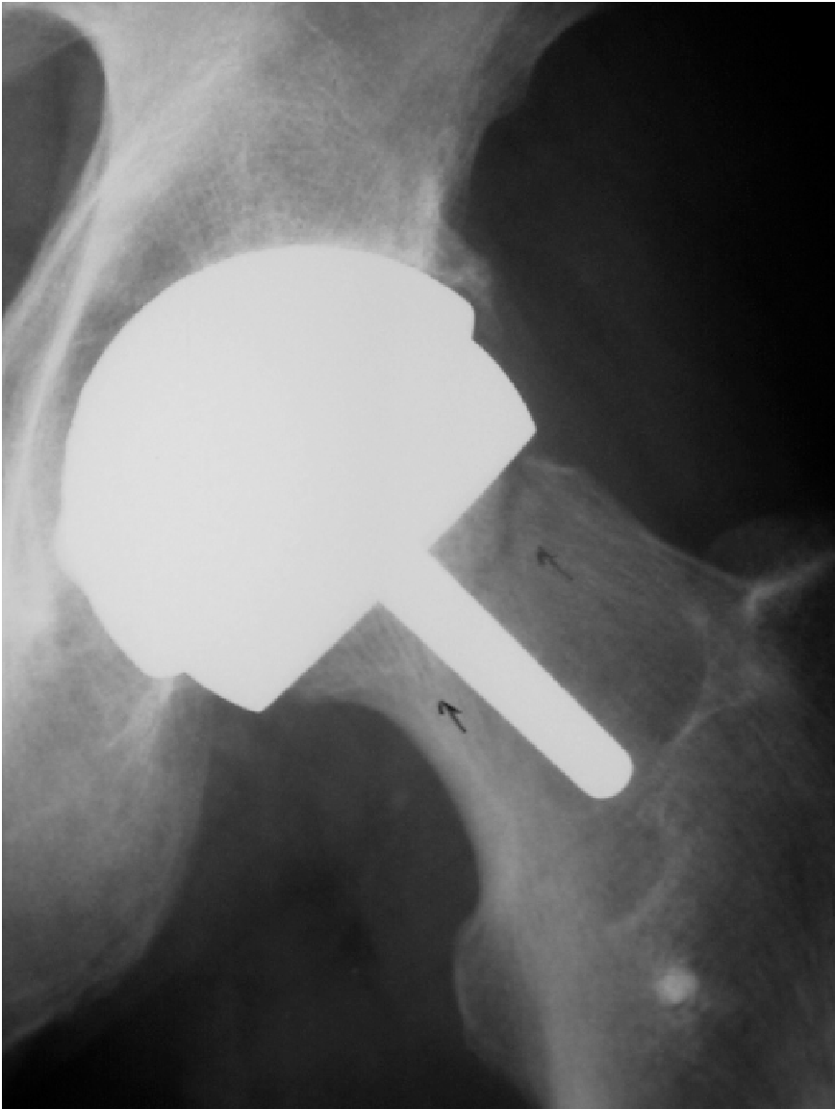
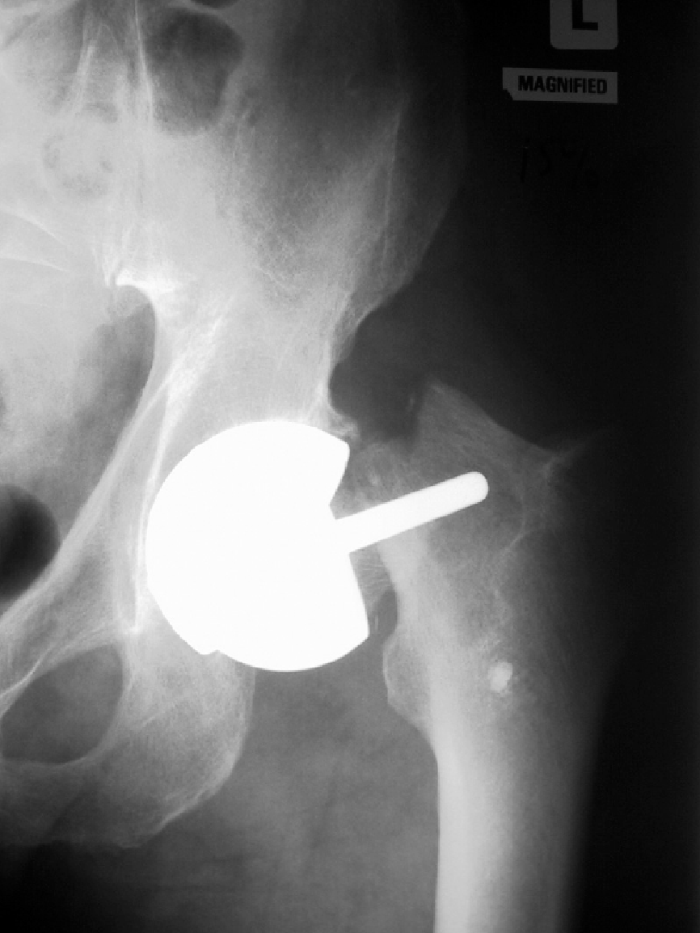
Complications and failure mechanisms
Clinical studies report femoral neck fracture as the most common
short- term failure mechanism.
In the long- term, extent of stress/strain shielding and bone remodelling
causing implant loosening.
Shimmin et al. (2008), Metal-on-Metal Hip Resurfacing Arthroplasty, J. Bone Joint Surg [Am], 90,637-654.

Slide 13
Geometry and Material Property
Hip Resurfacing Implant: Failure Mechanisms and Design Considerations
Ph.D. Scholar: Bidyut Pal (2006 - 2009)
Contour data from CT slices
(layer reconstruction)
Apparent density vs. CT- grey value
(linear calibration)
ρ = 0.11837 + 0.001141 HU
Elastic modulus vs. apparent density
(power law) E = 7281ρ^{1.52}; E in MPa, ρ in g·cm⁻³
FE model of bone, where each bone element is assigned individual material properties, based on CT-grey value.

Slide 14
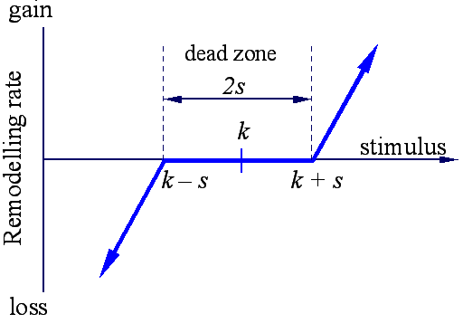
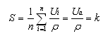
Bone Remodelling Simulations
The phenomenon of adaptive bone remodelling explains the response of bone tissue to a significant alteration of its stress / strain environment.
Rate of bone loss or gain ~ S – S_{ref}
S : Remodelling signal, implanted femur
S_{ref} : Reference signal, intact femur
Strain Energy per unit bone mass averaged over loading history.
s = ±75% of reference stimulus
Bone adapts its structure in accordance with the altered mechanical environment, by bone resorption (activity of osteoclasts) and apposition (activity of osteoblasts)
References: Theory of Bone Remodelling proposed by Huiskes et al. (1992), van Rietbergen et al. (1993) and Weinans et al. (1993)
‹#›

Slide 15
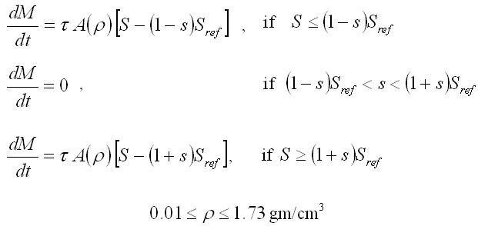
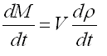
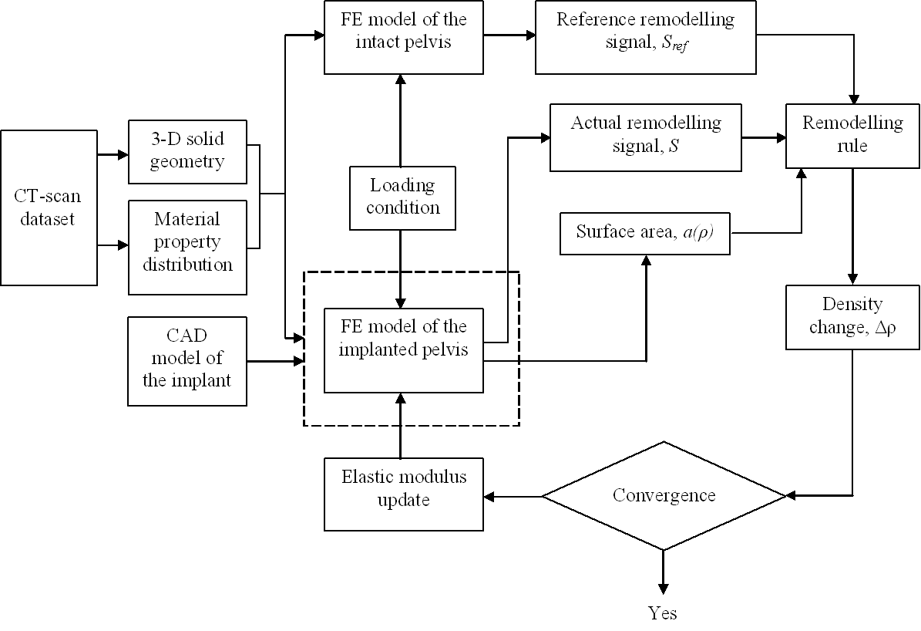
Mathematical formulation: Theory of Adaptive Bone Remodelling
s = ±75% of reference stimulus
A(ρ) = free surface area
a(ρ) = free surface area per unit volume
τ = adaptation rate
Δρ = change in bone density
Δt = time increment
‹#›

Slide 16
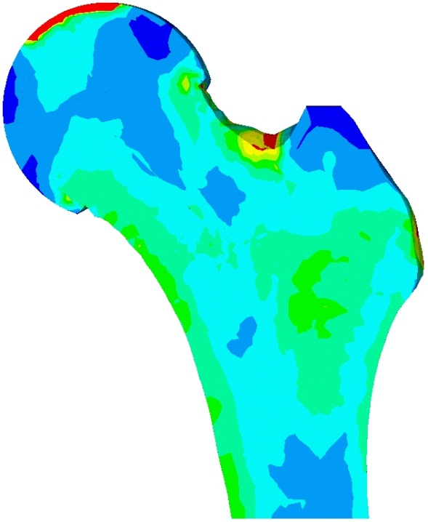
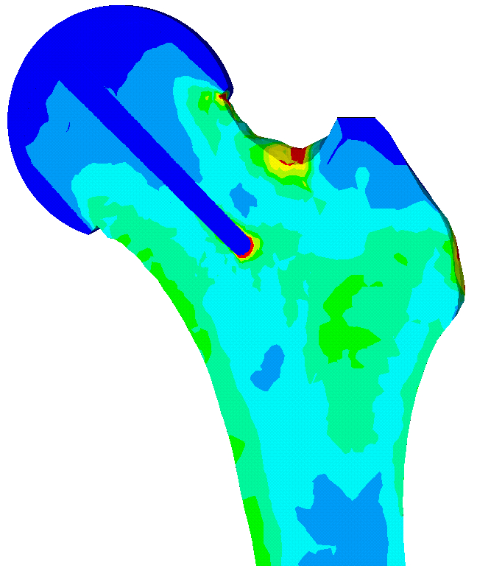
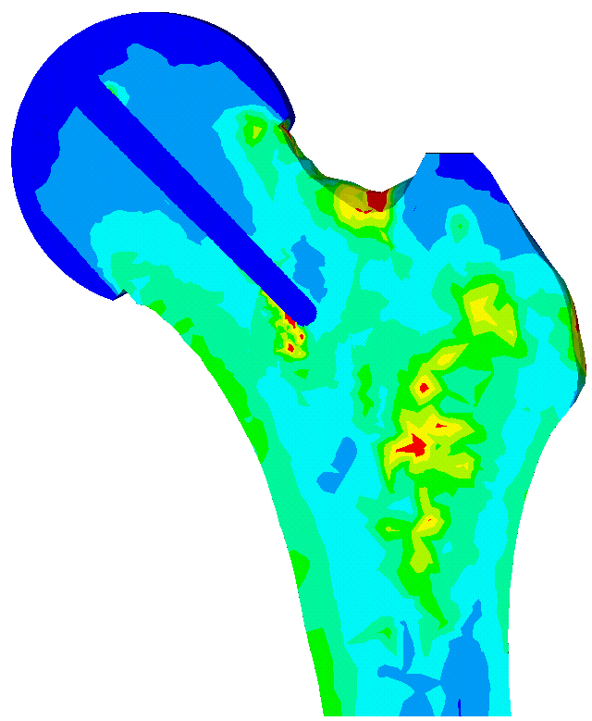
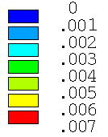
Deviations in Strain Distribution for full stem-bone contact (µ = 0, 0.25, 0.4): Metallic ASR Stair Climbing
Strain
Intact femur
Resurfaced femur
(immediate post-operative)
Resurfaced femur
(after 50 iterations)
Strain distribution: 0 – 0.7% strain
‹#›

Slide 17
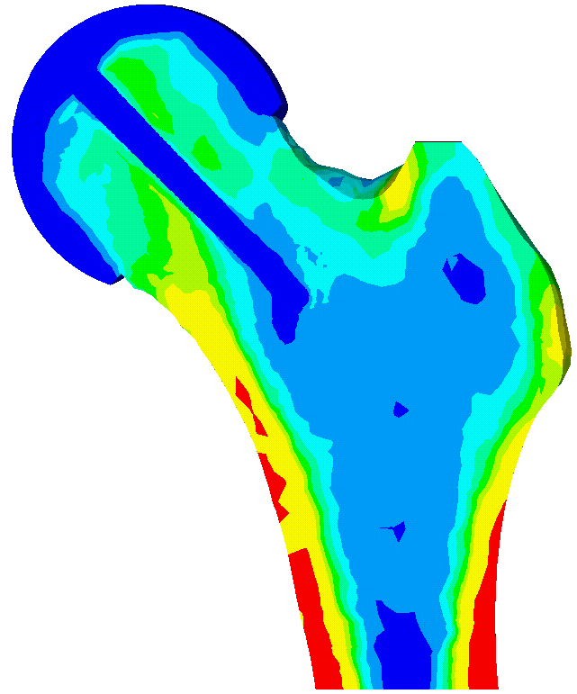
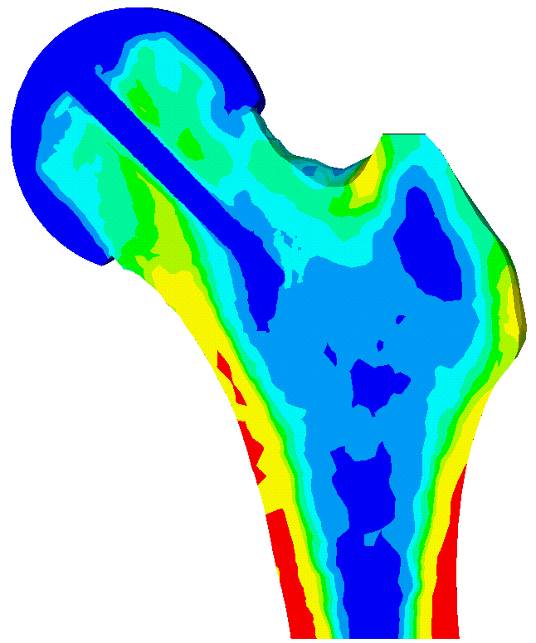
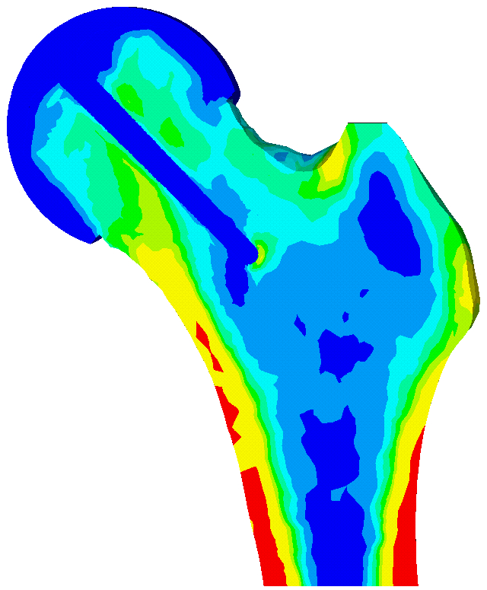
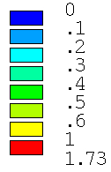
Predicted Changes in Bone Density
Post-operative
Full stem-bone contact; µ=0.25
Offset; µ=0
‹#›
Density (g cm⁻³)

Slide 18
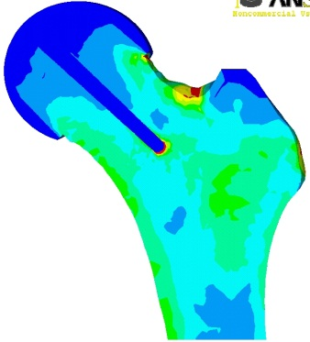
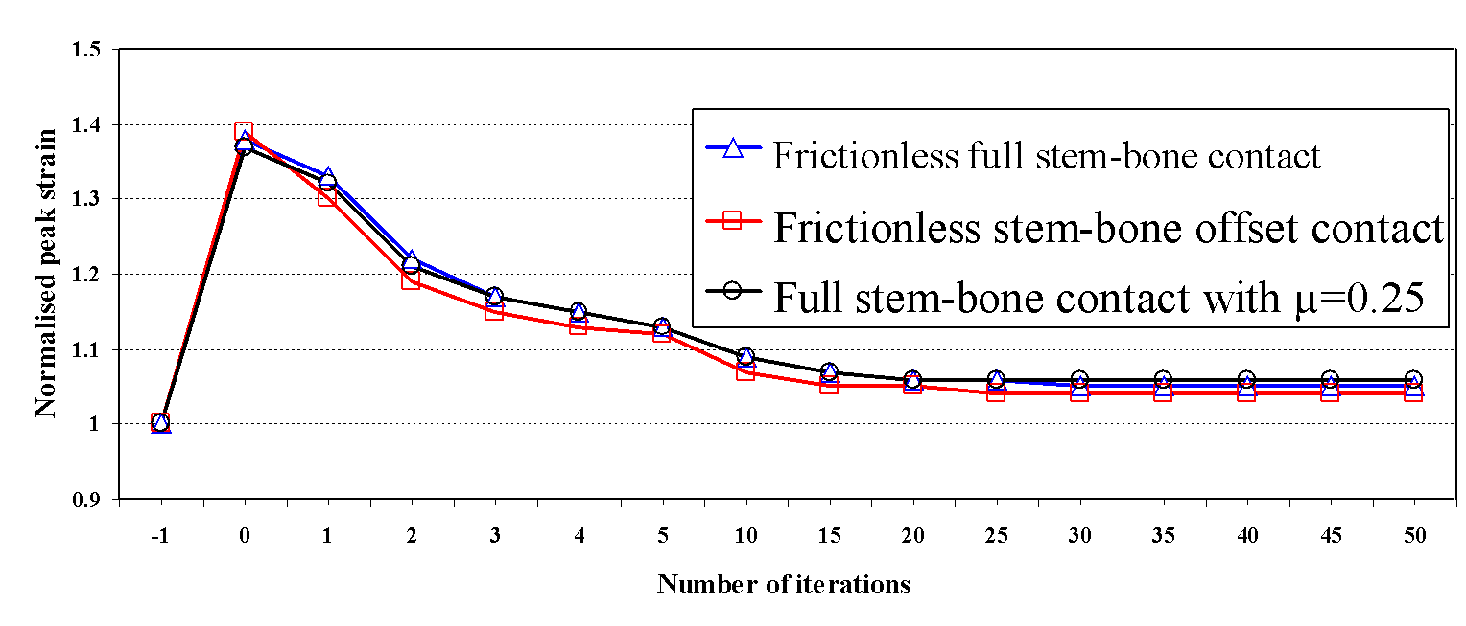
Changes in strain distribution
Critical Rehabilitation Period
Normalised peak strain is calculated with respect to intact femur;
-1: intact femur, 0: postoperative
‹#›
Published in Journal of Engineering in Medicine, Proc I Mech E, Part H, 2009.

Slide 19
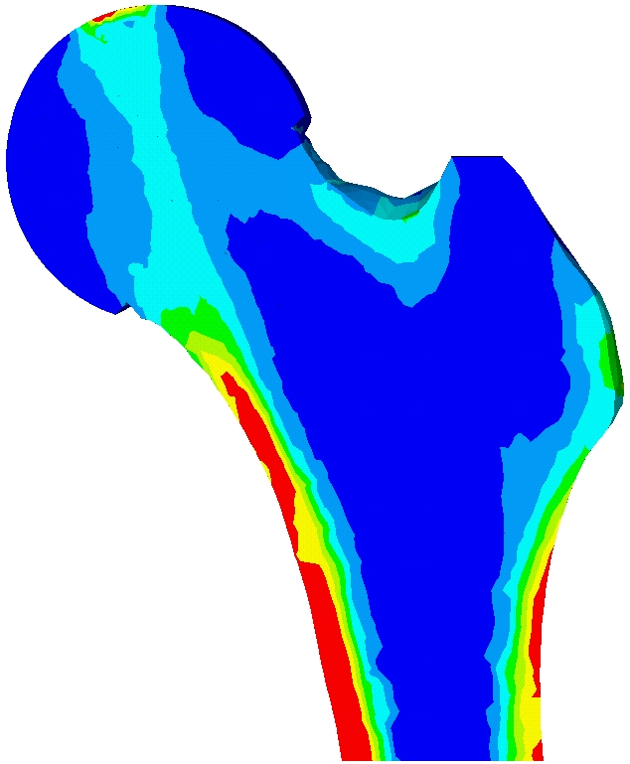
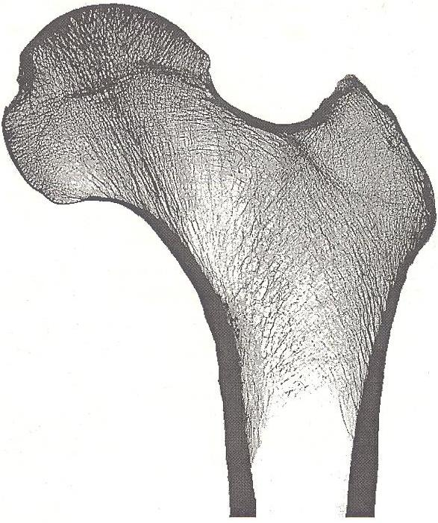
Conceptual Design
How Short?
clearance
Φ D
≈ D/2
≈ D
A radiograph of a coronal section from the proximal femur, showing trabecular orientation along the principal stress trajectory
Von Mises stress distribution in intact femur
‹#›

Slide 20
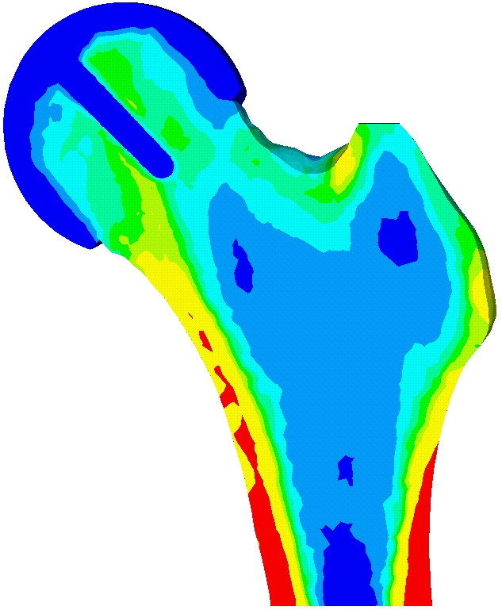
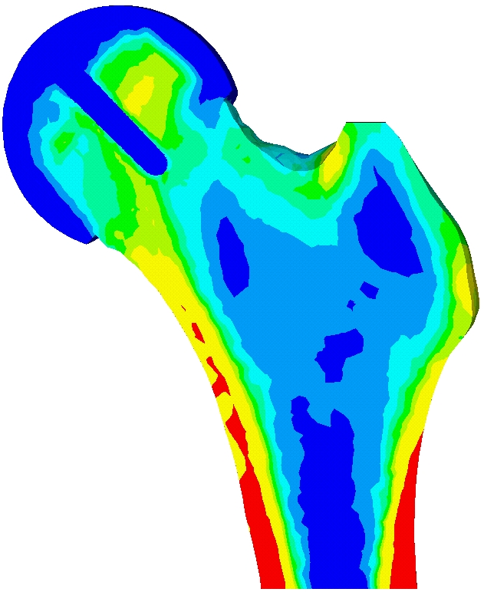
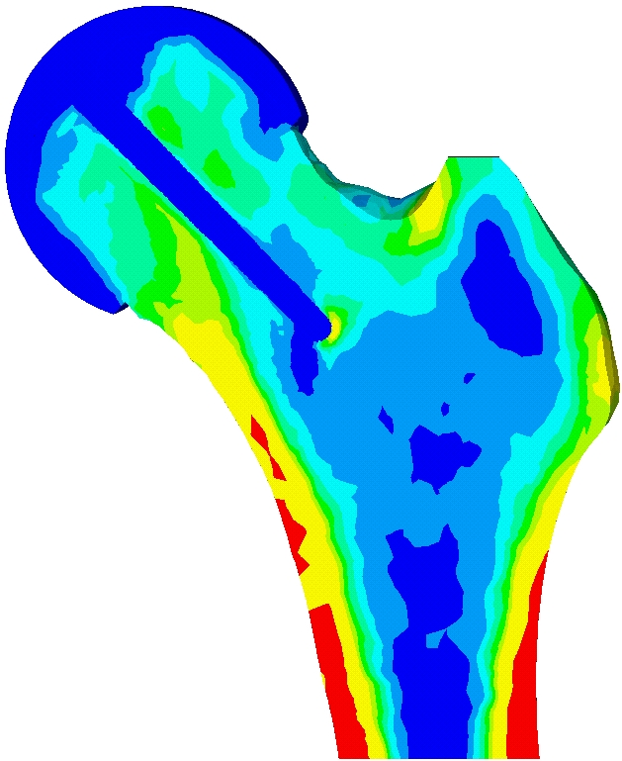
Predicted Changes in Bone Density: Short and Long Stem Designs
Short stem
Long stem
2
2
1
4
1
4
6
6
3
8
3
8
5
5
7
7
Post-operative
After equilibrium in bone remodelling
Density (g cm⁻³)
Pal et al. (2010), Journal of Biomechanics, 43(15), 2908-2914.
‹#›

Slide 21
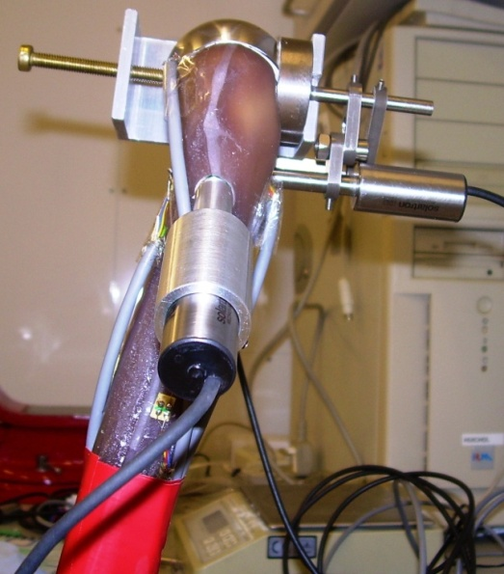




Experimental Investigations on Implanted Femur
(UKIERI Project)
LVDT 1
LVDT 2
LVDT 3
In-house designed and fabricated loading mechanism
LVDT 1
LVDT 3
LVDT 2
Implanted composite femur mounted with strain gauges and LVDTs
Pal et al. (2010), Journal of Biomechanics, 43 (10), 1923 – 1930.

Slide 22


Experimental strain versus numerical (FE) strain
Intact
Resurfaced
R : 0.94; SE: 198 µε
Slope: 0.86; Intercept: -109 µε
R : 0.95; SE: 241 µε
Slope: 0.86; Intercept: -74 µε
Symbol indicates single strain gauge output for all the load cases
‹#›

Slide 23



Measured versus FE micromotion
LVDT 1
LVDT 3
Target
LVDT 2
Experimental: Load vs Micromotion data
Published in Journal of Biomechanics, 2010
Comparison
‹#›

Slide 24
Major Findings
Strain concentration generated, post-operatively, at the proximal femoral neck region indicates a potential risk of neck fracture. However, it disappears with bone remodelling.
Although femoral hip resurfacing leads to conservation of bone stock, strain shielding and bone resorption might lead to eventual implant loosening.
In order to reduce the potential risk of neck fracture, patients should avoid activities which might induce high loading of the hip during early post-operative period and allow the bone around the neck-component junction to remodel.
The mechanical role of the stem appears to be crucial.
The short-term design offers better prospects than the currently used long-stem cemented resurfacing implant.

Slide 25



Biomechanical Analyses of the Pelvic Bone and Optimal Design Considerations for Uncemented Acetabular Prosthesis
Ph.D. Scholar: Rajesh Ghosh (2009 - 2013)
Background
Clinical feedback studies reported acetabular component loosening to be 2 to 3 times higher than that of femoral components.
One of the major causes behind aseptic loosening (failure) of the implant is due to mechanical factors.
Demand for more durable implants are increasing
- Young and active patients undergo replacements
- Increase in life expectancy of older patients
‹#›

Slide 26

Geometry and Material Property
Image processing of CT– scan data slices
Apparent density vs. CT- grey value
(linear calibration): ρ = 0.022 + 0.001038 HU
Elastic modulus vs. apparent density
(power law): E = 2017.3 ρ^{2.46}
Cortical bone E = 17 GPa
A FE model of bone, where each bone element is assigned individual material properties, based on CT-grey value.
The FE model contained 221947 number of elements.
‹#›

Slide 27


Experimental Setup for DIC measurement
(UKIERI Project)
Specimen
Camera
Camera
Camera
Camera
Ghosh et al. (2012), Trans. ASME, J. Biomech. Eng, 134(8), 081003(1 – 9)
‹#›

Slide 28


Strain and Micromotion Measurement in the Pelvic Bone
(UKIERI Project)
Cylindrical Post
LDS 3
LDS 2
Target
LDS 1
Experimental set-up
Equivalent FE model
Ghosh et al. (2013) J Eng Med, Proc Inst Mech Engrs Part H, 227(2), 162-174.
‹#›

Slide 29




Strain distributions (von Mises) in the intact and the implanted hemi-pelvises: DIC measured versus FE predicted strains
Superior
Anterior
Posterior
Inferior
Intact pelvis
Implanted pelvis
‹#›
Microstrain

Slide 30


Correlation between DIC measured and FE predicted strain
R = 0.956
SE = 69.53 µε
R = 0.938
SE = 75.09 µε
Intact pelvis
Implanted pelvis
‹#›

Slide 31


Correlation between measured (strain rosette) and FE predicted strain
R = 0.974
SE = 38.9με
R = 0.973
SE = 37.6με
(700 N: *, 800 N: ●, 900 N: ▲, 1000 N: +, 1100 N: ♦, 1200 N: ◄, 1300 N: ٭, 1400 N: ■)
Intact pelvis
Implanted pelvis
‹#›

Slide 32




Comparison of FE predicted and measured implant-bone micromotions
Medial-lateral direction (LDS 3)
Anterior-posterior direction (LDS 1)
Superior-inferior direction (LDS 2)
Ghosh et al. (2013) J Eng Med, Proc Inst Mech Engrs Part H, 227(2), 162-174.
‹#›

Slide 33



Applied Loading Conditions
Include eight phases (load cases) of a normal walking cycle
Hip-joint force
Muscle force: 21 muscle forces
Fixed constrains were applied at the pubis and the sacroiliac joint
‹#›
Anatomical femoral head with cartilage layer

Slide 34







Principal Stress Distributions Across the Hemi-pelvis
Load case 2: Beginning right single support (max hip-joint reaction force).
Stress (MPa)
Third Principal
First Principal
Stress (MPa)
Ghosh et al. (2013), Comp Meth Biomech Biomed Engg, 18(7), 697-710.
‹#›

Slide 35





Stress (von Mises) Distributions after Implantation
(a)
Cut-boundaries (nodal displacements are transferred at these boundaries from full model).
Acetabular component
Full model
Submodelling Technique: Implanted Pelvis
Submodel
‹#›
Stress (MPa)

Slide 36






Changes in Bone density distribution: Metallic / Ceramic implant
1
2
1
2
1
2
3
4
3
4
3
4
Immediate post-operative
Bonded implant-bone interface
Debonded implant-bone interface
(ROI 1: ■; ROI 2: ●; ROI 3: ▼; ROI 4: ▲).
Density (g cm⁻³)
Ghosh et al. (2013) J Eng Med, Proc Inst Mech Engrs Part H, 227(5), 490-502.
‹#›

Slide 37



Composite Acetabular Components
Investigations on variation in: (1) Design, (2) Thickness
Prosthesis 1
Prosthesis 2
Prosthesis 3
3mm thick UHMWPE bearing, interlocked with 1.5 mm thick CFR-PBT (Cambridge Cup)
3mm thick CFR-PEEK (Mitch PCR Cup)
3mm thick CFR-PEEK (Hemispherical Cup)
E_{CFR-PBT} = 16.6 GPa, ν = 0.4; E_{UHMWPE} = 1.174 GPa, ν = 0.45
E_{CFR-PEEK} = 13 GPa, ν = 0.4
Ghosh and Gupta (2014), J Mechanical Behavior Biomedical Materials, 32, 257-269.
‹#›

Slide 38





Changes in bone density distributions around composite acetabular implants
1
2
1
2
3
4
3
4
Immediate post-operative
Prosthesis 1
Density (g cm⁻³)
1
2
1
2
3
4
3
4
‹#›
Prosthesis 2
Prosthesis 3

Slide 39











Effect of implant thickness: Bone Density Changes for CFR-PEEK implant
Section 1 – 1
Section 1 – 1
Section 1 – 1
Section 2 – 2
Section 2 – 2
Section 2 – 2
Density (g cm⁻³)
Section 3 – 3
Section 3 – 3
Section 3 – 3
Post-operative
Bone Remodelling with 3 mm thick implant
Bone Remodelling with 11 mm thick implant
‹#›

Slide 40
Major Findings
The effect of strain shielding was observed at the central part of the acetabulum, whereas a pronounced strain increase was observed around the periphery of the acetabulum.
Strain shielding was considerably higher for the bonded implant-bone interface condition as compared to the debonded implant-bone interface condition.
Horse shoe-shaped CFR-PEEK appears to be a better suited alternative bearing surface than other designs with regard to strain shielding, bone deformation and bone remodelling.
Thickness of the acetabular component also played a crucial role in implant-induced bone adaptation.
‹#›

Slide 41




Shape Optimization of Hip Prostheses
Ph.D. Scholar: Souptick Chanda (2012 - 2015)
Background and Motivation
Aseptic loosening of femoral stems is influenced by the following mechanical factors related to the design of the implant:
Stem geometry
Implant material
Length of porous coating
A study to determine the optimal combination of these factors towards an improved hip prosthesis is, therefore, necessary.

Slide 42





Shape Optimization : Parameterization
Eighteen (18) design parameters
TriLock (DePuy) Hip Stem
‹#›

Slide 43




Objective Function Formulation and Design Goal
Objective function 1:
Stress shielding
Objective function 2:
Resorbed Bone Mass Fraction
Interface stresses
Hoffman Failure Index
Minimize Objective 1 (f1)
Minimize Objective 2 (f2)
subject to
a2 – a1 ≥ 0, b2 – b1 ≥ 0, a4 – a2 ≥ 0, b3 – b2 ≥ 0, a6 –a4 ≥ 0, b4 – b3 ≥ 0,
a3 – a2 – 4.5 ≥ 0, a5 – a3 – 4.5 ≥ 0, a5 – a3 – 7.0 ≤ 0 and a2 + a5 – 2.0 × a3 ≥ 0
Implant material selected: Ti-alloy (E=110 GPa)
‹#›

Slide 44







Shape Optimization Framework
Titanium
alloy
NSGA-II
SolidWorks
New design
parameters
Optimization
process
Ansys
Rhinoceros
Chanda et al. (2015), Trans ASME J Biomechanical Engg, 137, 034502 (1-12)
‹#›

Slide 45



Pareto-optimal Front and three Optimal Stem Geometries (OSG’s)
Pareto-optimal front derived from the scatter plot
Optimization
direction
OSG-1
OSG-2
OSG-3

Slide 46




Adaptive Bone Density Changes: a Comparative Study
Immediate Post-op.
Long-term Post-op.
Immediate Post-op.
Long-term Post-op.
-55%
-18%
0
0.10
0.20
0.30
0.50
0.80
1.00
1.20
1.73
-67%
-28%
-42%
-4%
-36%
-10%
g.cm⁻³
‹#›
Initial Geometry
OSG-1

Slide 47




Adaptive Bone Density Changes: a Comparative Study contd.
Immediate Post-op.
Long-term Post-op.
Immediate Post-op.
Long-term Post-op.
-22%
-17%
0
0.10
0.20
0.30
0.50
0.80
1.00
1.20
1.73
-26%
-31%
-6%
-3%
-8%
-7%
g.cm⁻³
‹#›
OSG-2
OSG-3

Slide 48
Major Findings
A novel patient-specific multi-objective shape optimization scheme has been proposed for cementless femoral implant design.
The optimal implant designs yielded favourable proximal load transfer and reduced chances of interface failure; adaptive bone remodelling was also minimized for the optimized designs.
It appears that the GA is an effective shape optimization tool and the proposed method can serve as a major step towards customized implant design by implementing this method on a statistical femur model.
‹#›

Slide 49

Micro-scale Simulation of Bone Ingrowth
Ph.D. Scholar: Kaushik Mukherjee (since May 2012)
Background
Cementless implants rely on biological fixation with bone.
Bone ingrowth is known to follow the principle of fracture healing.
Over the last two decades, mechanoregulatory algorithms have been developed to quantitatively assess the tissue differentiation.
Motivation
It is necessary to gain an insight into the predictions of peri-prosthetic bone ingrowth by two commonly used mechanoregulatory tissue differentiation algorithms:
Phenomenological
Cell-phenotype specific
‹#›

Slide 50



The Goal of the Study
Using a three-dimensional (3D) microscale FE model representing an implant-bone interface, the objective of the study is to quantitatively compare tissue differentiation predictions by the cell-phenotype specific and the phenomenological algorithms.
The study is focused on:
Acetabular component
Variation in regional bone material properties across the acetabulum
Variation in implant-bone relative displacement across the acetabulum
‹#›

Slide 51
Mechanical Factors Governing Peri-prosthetic Bone Ingrowth
Surface Texture Design
Material Property (Bone and Implant)
Boundary Conditions
Mechanical Environment
Peri-prosthetic Bone Ingrowth
‹#›

Slide 52

Salient Features:
Diffusion based modelling
Cell differentiation is governed by mechanoregulatory principle
Explicit tissue formation is not modelled
Salient Features:
Cell migration, proliferation, differentiation and apoptosis are modelled separately
Extracellular matrix formation and tissue degradation are considered in the model
Coefficients of all the biological phenomenons are governed by mechanoregulatory principle
‹#›

Slide 53

Tissue Differentiation algorithm: Phenomenological algorithm
Cell Proliferation Cell Migration
Diffusion Constant (k): 0.1 mm³/day (Lacroix et al. 2002)
Cell differentiation
Mechanoregulatory Principle
Extracellular Matrix generation and tissue formation is not explicitly modelled.
(Lacroix and Prendergast 2002)
‹#›

Slide 54
Tissue Differentiation algorithm II:
Cell-phenotype specific algorithm: Cell formation
Mesenchymal Cell
Migration
Proliferation
Differentiation
Apoptosis
Fibroblast Cell
Chondrocyte Cell
Osteoblast Cell
All the coefficients depend on Mechanoregulatory principle!!!
‹#›
(Andreykiv et al. 2008, Isaksson et al. 2008)

Slide 55



Tissue Differentiation algorithm II: Cell-phenotype specific algorithm: Tissue formation
Bone Tissue
Tissue Formation
Tissue Degradation
Cartilage Tissue
Fibrous Tissue
All the coefficients depend on Mechanoregulatory principle!!!
(Andreykiv et al. 2008, Isaksson et al. 2008)

Slide 56
Mechanoregulatory Principle
Predicted Tissue Type | Strain Stimulus (%) | Hydrostatic Pressure (MPa)
Fibrous Tissue | - >5 <-5 | >0.15 >-0.15 >-0.15
Cartilage | >15 <-15 | <-0.15
Immature Bone | -15 to 15 | ≤-0.15
Mature Bone | - 5 to 5 | -0.15 to 0.15
Strain Stimulus: Octahedral Shear Strain
‹#›
Claes & Heigele (1999), J Biomech, 20: 255-266

Slide 57

Mapping of Displacement Field and Bone Material Properties from Macro-to-Microscale Model
Dimensions (in mm): 4(l) × 2.4(w) × 2.8(h)
Features of Micro-scale FE Model:
Element edge length: ~40 μm
Total Elements: 124312
Total Nodes: 171079
Applied Boundary Conditions:
Top Surface: Mapped from Acetabulum
Bottom Surface: Mapped from Implant
Lateral Surfaces: Periodic Boundary Condition
‹#›

Slide 58

Results
Tissue Differentiation Predictions:
Phenomenological Algorithm
6
✔
Red: 12-25% BI
Black: 45-55% BI
Purple: 60-70% BI
Blue: 75-90% BI
BI: Bone Ingrowth
13
7
2
✔
✔
12
5
1
3
8
4
✔
11
9
10
‹#›

Slide 59


Results
Tissue Differentiation Predictions:
Phenomenological Algorithm
Mukherjee and Gupta (2015), Biomechanics in Modeling and Mechanobiology , In Press.
‹#›

Slide 60



Results
Tissue Differentiation Predictions:
Phenomenological Algorithm
The average Young’s modulus of newly formed tissue layer was observed to increase with time in all the 13 regions.
The strains in the newly formed tissue layer for all the regions were observed to decrease with time following a similar pattern as observed by Isaksson et al. (2006).
Overall FE Predicted Bone Ingrowth : 45.6% ± 24.6 (13-88)
(averaged over 13 regions, single acetabular component)
Clinical (histological and radiographic) Studies:
Hanzlik & Day (2013):
Titanium Acetabular Shell: 46±20% (20–83)
76 different acetabular components
Engh et al. (1993):
Porous Coated Acetabular Implant: 33% (3-84)
9 different acetabular components
‹#›
Hanzlik & Day (2013), J Arthrop, 28: 922-927
Engh et al. (1993), JBJS (Am), 75: 814-824

Slide 61


Results
Tissue Differentiation Predictions
Phenomenological vs Cell-phenotype
Percentage Bone Ingrowth
Tissue Differentiation around the Acetabular Prosthesis after Attainment of Equilibrium
‹#›

Slide 62

Results
Tissue Differentiation Predictions
Phenomenological vs Cell-phenotype
Percentage Bone Ingrowth
Lateral Shift
‹#›
Iterations (Days)

Slide 63
Major Findings
The overall tissue differentiation predictions of phenomenological and cell-phenotype specific algorithms were found to be similar.
Cell phenotype specific algorithms are of prime importance where the cellular interaction with implant surface is required to be studied.
The phenomenological algorithm, being computationally less expensive, is a suitable alternative to the cell-phenotype specific algorithm in order to gain an insight over the peri-prosthetic tissue differentiation process.
‹#›

Slide 64
Acknowledgements
Indian Institute of Technology Kharagpur
Department of Biotechnology, New Delhi
University of Southampton, U.K.
UKIERI, British Council
‹#›

Slide 65

Thank you for listening
‹#›

Slide 66


IIT Kharagpur over the Decades
Vision 2020: World Class Technology based University
Global Partnership with Peer Institutions.
Be among top 20 tech Institutions in 20 years
2010: Medical Education , Engineering Design and
Manufacturing, Entrepreneurship, Science Park,
Fund Raising for the Institute
2000’s: Intern’l R&D Centres, Energy, NanoTech,
Water, Infra, Incubation, IPR Law
1990’s: Multi-disciplinary Centres, ATDC, Missions,
Entrepreneurship Park, Business Management
1980’s: CSE, Biotechnology,
Industrial Engineering, SRIC
1970’s: Capacity Growth, Sponsored
Research & Consultancy
1960’s: Growth in Engineering,
Science, HSS, Vibrancy in Academic Research
1950’s: Establishing the IIT Education System
with 224 students and 42 teachers
‹#›

Slide 67
IIT Kharagpur – at a glance
19 Depts, 9 Centres, 8 Schools, 25 + Special R&D Units
Total: 2365, PhD(247)
Graduating
Batch
Academic
Engineering, Basic Science, Bioscience, Social Science, Humanities, Mgmt,
Law, Entrepreneurship
Research
Publications
2500+ (1500+ J, 1000+ C)
Broad
Disciplines
INR 175 Crore / year
Funded
Projects
B.Tech.(15), B.Arch, Dual Degree(35), MBA, MHRM, LLB, MMST, M.Sc/ M.Tech/ MCP/ MS(68), PhD
Academic
Programmes
Patents
Filed
70 to 100 / year
Total Student Strength
11,244 students (55% UG, 25% PG, 20% PhD)
INR 1 Crore / year
Technology
Licensing
Faculty &
Staff
615 faculty, 1002 staff
Technology
Developed
187 (Total)
Residence Quarters
1683
Total No. of Hostels
21
2100 acres (approx)
Area
‹#›

Slide 68

Hounsfield Units or CT numbers
In a CT-scan image, each pixel is assigned a numerical value (CT number), which is the average of all the attenuation values contained within the corresponding voxel. This number is compared to the attenuation value of water and displayed on a scale of units named Hounsfield units (HU), after Sir Godfrey Hounsfield.
Bone +400 to +1000
Soft tissue +40 to +80
Water 0
Fat -60 to -100
Lung -400 to -600
Air -1000
Cortical Bone: 2000 - 3000
Approximate range of CT numbers
‹#›

Slide 69

Steps of Geometric Modelling from QCT-scan data
Thresholding means segmentation of the image that contains only those pixels with a value higher than or equal to the threshold value. Sometimes an upper and a lower threshold value are required. The image then contains all pixels between these two values.
Region Growing tool makes it possible to split the segmentation created by thresholding into several objects and to remove floating pixels.
‹#›

Slide 70

Contour Detection
Edge or contour of the slices of the CT-scan data can be detected using the contour detection algorithm, available in software (e.g. MIMICS, Simpleware)
Detected outer contour of femur and pelvic bone
‹#›

Slide 71





Method
Export STL geometry to Ansys ICEM CFD mesher
Find edges with “Build Topology” and use them to constrain the FE mesh, using the STL triangles
Mesh ready to export to FE software
Finalised mesh in Ansys. Just to separate meshes in interface bone-implant.

Slide 72





Method
Import STL femur model from CT segmentation package (Mimics/Amira)
Import prosthesis (STL or any CAD format)
Move the implant to the “datum” position (never the femur)
Export
Cutter for osteotomy (alternative real femoral broach)
Boolean operations: Remove femoral head, femur & implant are partitioned

Slide 73


Scheme for Mechanoregulatory Tissue Differentiation Simulation
Initiation of Tissue Differentiation Simulation
Tissue Distribution at Equilibrium Condition
YES
NO
Equilibrium Attained?
Structural Analysis
Geometry
Material Properties
Loads
Boundary condition
Diffusion Model Analysis
Geometry
Material Properties
Loads
Boundary condition
Mechanical Stimulus
Tissue Differentiation Algorithm
Updated Material Properties
Cellular Concentration
Neo-Tissue Phenotype
‹#›

